Slide 1


BUBBLE SHOOTER

Slide 2

Team Members
Anjan Shrestha
Santosh Kumar Yadav
Simon Pokhrel

Slide 3

TABLE OF CONTENTS
01
04
02
05
03
06
INTRODUCTION
SCOPE
ALGORITHM
SYSTEM REQUIREMENT
OBJECTIVES
CONCLUSIONS

Slide 4

<01> INTRODUCTION

Slide 5

01
Bubble Shooter is the Addictive Arcade game available in verities of OS. It is a clone of the Puzzle Bobble arcade game made by Taito in 1994, Which is in Japan.

Slide 6


About Bubble Shooter
The “Bubble Shooter” is a Java project which aims to replicate the popular mobile game’s thrilling and addictive experience with popping bubbles and endless gaming mode.
The main Goal of this game is to get highest score possible while demonstrating Java’s capabilities for game development.

Slide 7
<02> ALGORITHM

Slide 8
Algorithm
Step 1: Start
Step 2: Initialize the Game.
Step 3: Generate the bubbles.
Step 4: Display game Board.
Step 5: Player shoot Bubbles.
Step 6: Check for Bubbles matches.
6.1: If, bubbles match 3 or ore than three, go to step 7.1.
6.2: Else, go to step 7.2.
Step7: Update Score.
7.1: Add {20*(no. of bubbles match in previous score)}.
7.2: Add 10 score in previous score.
Step 8: Check for win condition.
8.1: If, no bubble left, go to step 9.
8.2: Else, go to step 5.
Step 9: Display Score.
Step 10: End

Slide 9
<03> objectives

Slide 10
Objectives
1
2
3
4
Clear Screen
Aim Precisely
Score Points
Entertainment

Slide 11
<04> Scope

Slide 12
SCOPE
User Interface (UI)
Bubble Physics
Gameplay Mechanics
Level & progression
Sound

Slide 13
<04> System Requirement

Slide 14
System Requirement (minimum)
OS: Windows 7, Linux , or MacOS 10.12
Memory: 2GB RAM
Storage: 500MB of available space
Input: Keyboard and mouse

Slide 15
Conclusion
"In conclusion, our Bubble Shooter game offers a fun and engaging experience for players of all ages. With its intuitive gameplay, colorful graphics, and never-ending level, it provides hours of entertainment and a sense of achievement as players aim to clear bubbles and achieve high scores.”

Slide 16
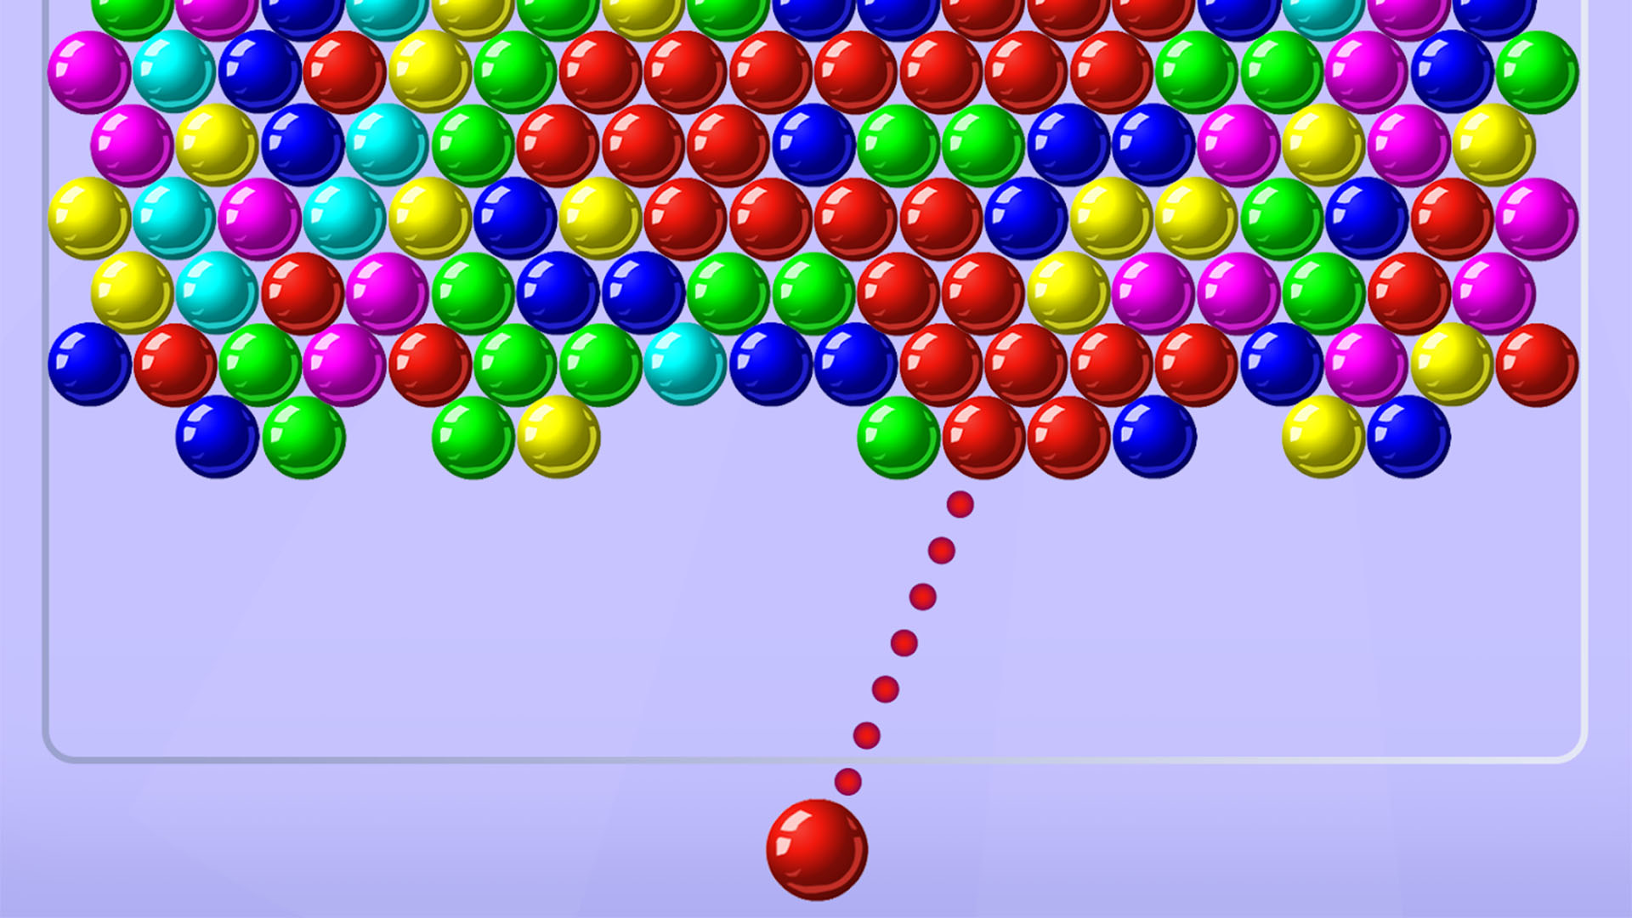
THANK YOU!

